Slide 1


ACT: Architectural Carbon Modeling Tools
@ MICRO 2024
Tutorial
Leo Han
Udit Gupta

Slide 2

ACT Tutorial: Today
Time | Topic
1:00 – 1:15pm | Welcome to the ACT tutorial!
1:15 – 1:30pm | Motivation: Understanding the source of computing’s emissions
1:30 – 2:15pm | Overview of ACT: An Architectural Carbon Modeling Tool
2:15 –2:45pm | Hands-on ACT demo’s
2:45 – 3:00pm | Extending ACT
3:00 – 3:30pm | Coffee break
Notes:
Finally, given our understanding of carbon emissions, we will conclude by charting paths for how to design future sustainable computing systems.

Slide 3
Tackling computing’s carbon footprint requires optimizing emissions across hardware life cycles (manufacturing and operational use)
Notes:
How have these advances affected computing’s overall environmental sustainability and more specifically carbon footprint.

Slide 4
Tackling computing’s carbon footprint requires optimizing emissions across hardware life cycles (manufacturing and operational use)
But (unlike performance, power, energy) there is a distinct lack of architectural tools and infrastructure to quantify carbon
Notes:
How have these advances affected computing’s overall environmental sustainability and more specifically carbon footprint.

Slide 5
Challenge: How do we design sustainable systems by considering the footprint across lifecycles
This work: Architectural Carbon Modeling Tools (ACT)

Slide 6

Challenge: How do we design sustainable systems by considering the footprint across lifecycles
This work: Architectural Carbon Modeling Tools (ACT)
Overview of ACT

Slide 7

Challenge: How do we design sustainable systems by considering the footprint across lifecycles
This work: Architectural Carbon Modeling Tools (ACT)
Overview of ACT
Comparing ACT to other methodologies

Slide 8

Challenge: How do we design sustainable systems by considering the footprint across lifecycles
This work: Architectural Carbon Modeling Tools (ACT)
Overview of ACT
Comparing ACT to other methodologies
Sustainability aware-design case studies

Slide 9
Challenge: How do we design sustainable systems by considering the footprint across lifecycles
This work: Architectural Carbon Modeling Tools (ACT)
Overview of ACT
Comparing ACT to other methodologies
Sustainability aware-design case studies

Slide 10
Architectural Carbon Modeling Tools (ACT)
Arch. Carbon Model
Carbon–aware HW design metrics

Slide 11




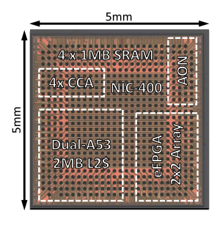
Architectural Carbon Modeling Tools (ACT)
Fab
Environmental
SW design &
performance
Arch. Carbon Model
Carbon–aware HW design metrics
HW design &
power

Slide 12
Architectural Carbon Modeling Tools (ACT)
Fab
Environmental
SW design &
performance
Arch. Carbon Model
Carbon–aware HW design metrics
Operational CO₂
Embodied CO₂
HW design &
power
CO₂ -aware
HW optimization

Slide 13
Architectural Carbon Model
Model
Hardware/software input

Slide 14

Architectural Carbon Model
Model
Hardware/software input
Performance/power/energy and
lifetime of hardware

Slide 15


Architectural Carbon Model
Model
Hardware/software input
Performance/power/energy and
lifetime of hardware
Energy efficiency and
environment (carbon intensity)

Slide 16
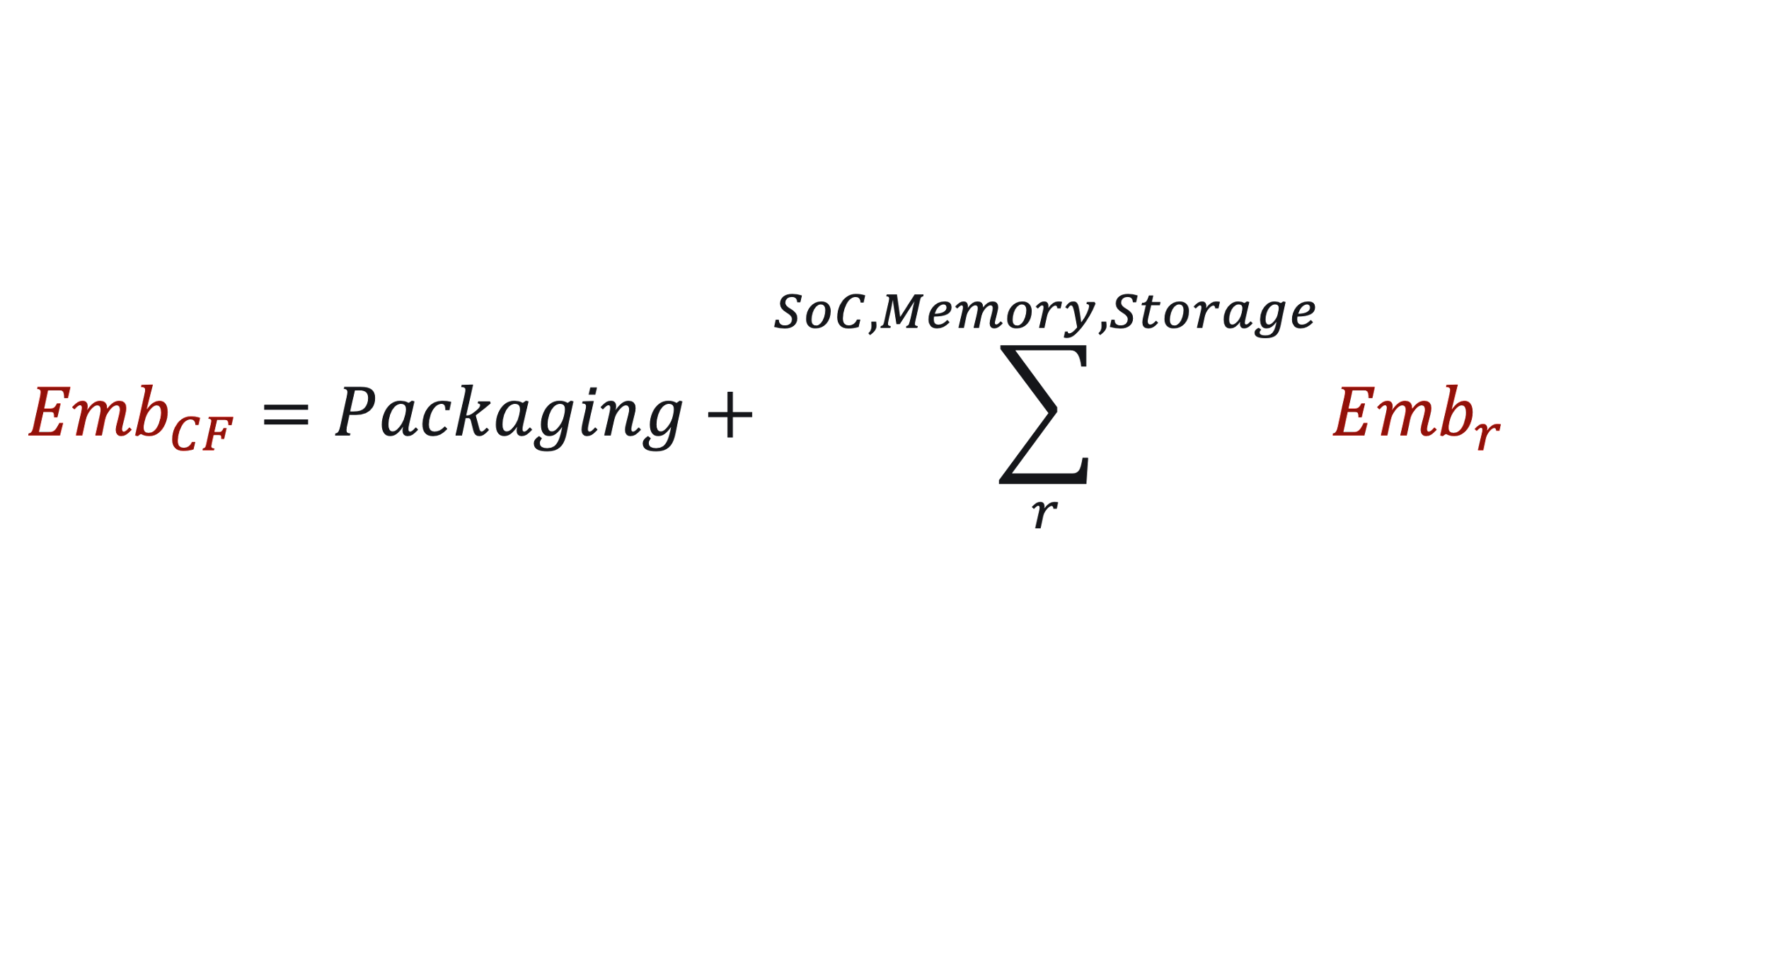
Architectural Carbon Model
Model
Hardware/software input
Performance/power/energy and
lifetime of hardware
Energy efficiency and
environment (carbon intensity)
Overhead of hardware
manufacturing

Slide 17
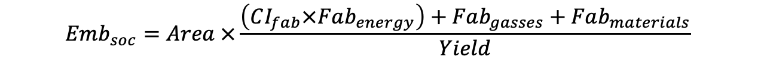
Embodied carbon of application processors (SoC’s)
$$Emb_{soc}=Area ×\frac{\left(CI_{fab}×Fab_{energy}\right)+Fab_{gasses}+Fab_{materials}}{Yield}$$
Notes:
We add the energy, chemicals, and materials used by the fab.
And factor in yield of manufacturing

Slide 18
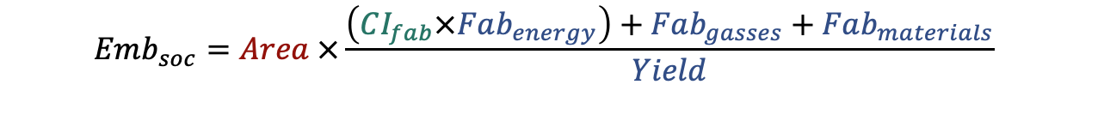
Embodied carbon of application processors (SoC’s)
Energy
source (grid)
Device and fab characterization
(industry fabs, device data)
$$Emb_{soc}=Area ×\frac{\left(CI_{fab}×Fab_{energy}\right)+Fab_{gasses}+Fab_{materials}}{Yield}$$
Hardware design

Slide 19
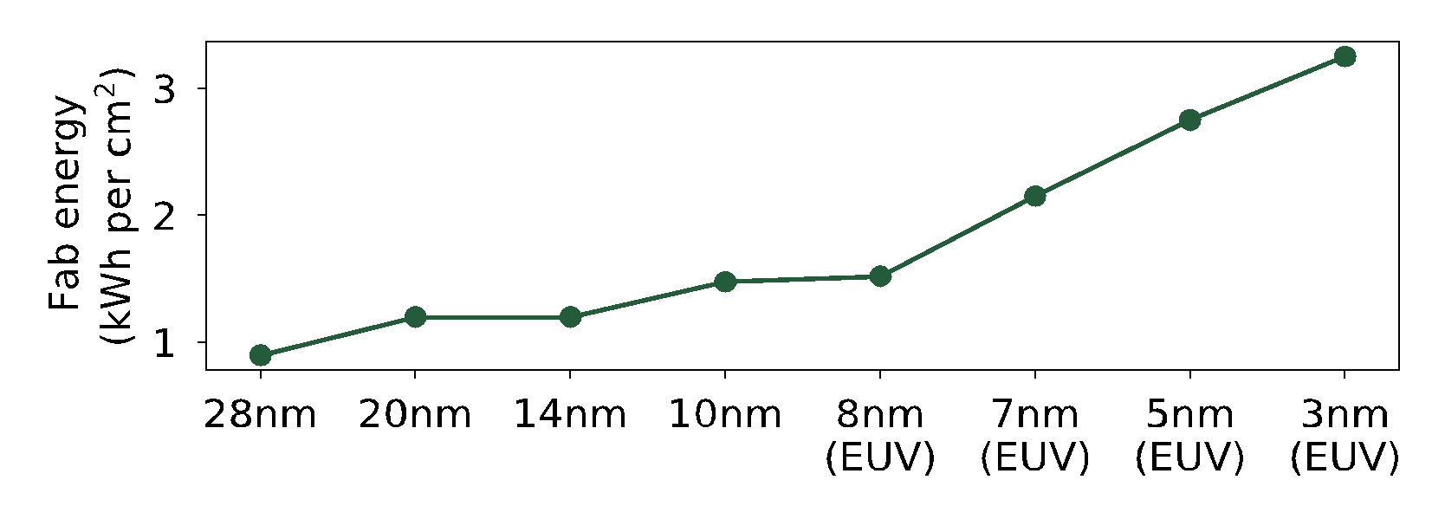
Embodied carbon of application processors (SoC’s)
Fab energy increases over tech. nodes
DTCO including Sustainability: Power-Performance-Area-Cost-Environmental score (PPACE) Analysis for Logic Technologies. Bardon et. al (IEDM 2020)

Slide 20
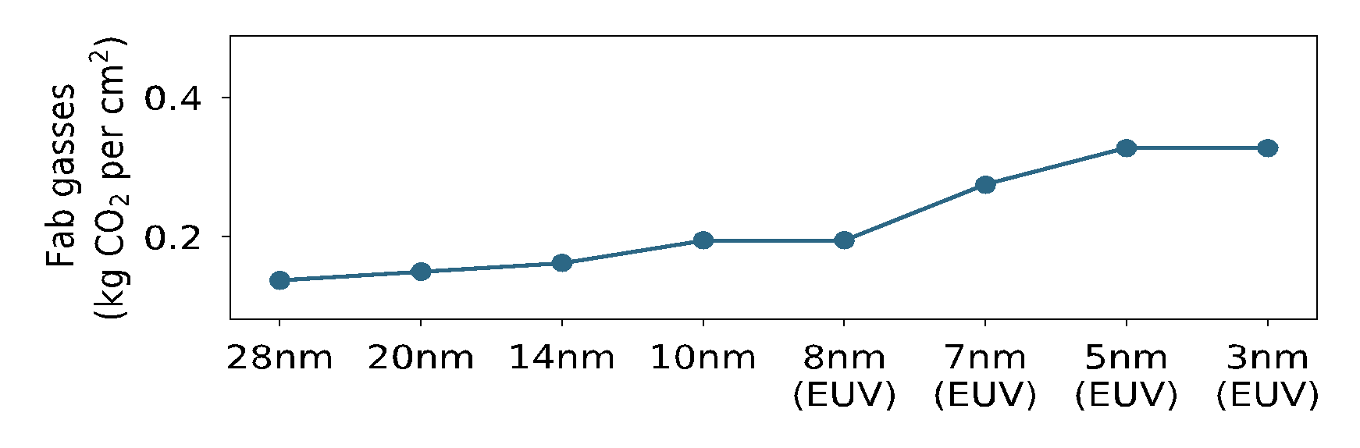
Embodied carbon of application processors (SoC’s)
Fab energy increases over tech. nodes
95% abatement
TSMC (97%)
99% abatement
DTCO including Sustainability: Power-Performance-Area-Cost-Environmental score (PPACE) Analysis for Logic Technologies. Bardon et. al (IEDM 2020)

Slide 21

Embodied carbon of application processors (SoC’s)

Slide 22
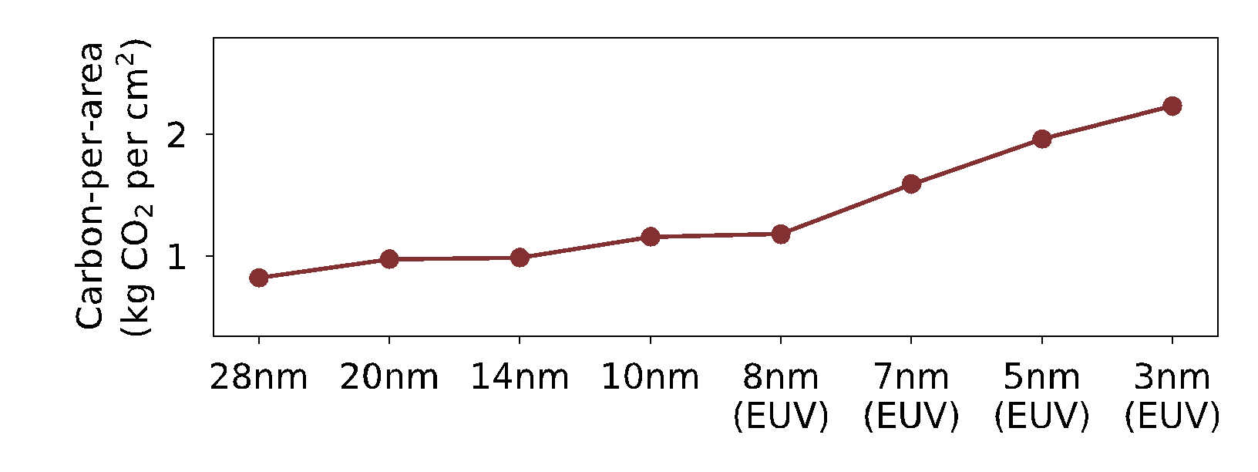
Embodied carbon of application processors (SoC’s)
Data sources:
[IMEC] DTCO including Sustainability: Power-Performance-Area-Cost-Environmental score (PPACE) Analysis for Logic Technologies. Bardon et. al (IEDM 2020)
[TSMC] TSMC Sustainability Reports 2018-2020

Slide 23
Embodied carbon of application processors (SoC’s)
TSMC 2025 goal
(25% renewable)
Fab with coal
(0% renewable)
Fab with solar (100% renewable)
Data sources:
[IMEC] DTCO including Sustainability: Power-Performance-Area-Cost-Environmental score (PPACE) Analysis for Logic Technologies. Bardon et. al (IEDM 2020)
[TSMC] TSMC Sustainability Reports 2018-2020

Slide 24

Embodied carbon of DRAM memory
DRAM
from SK Hynix’s sustainability reports

Slide 25
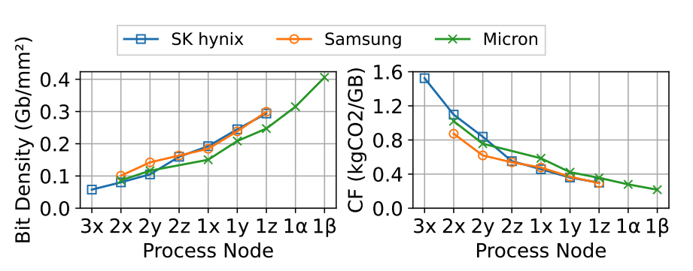
Embodied carbon of DRAM memory
https://hotcarbon.org/assets/2024/pdf/hotcarbon24-final154.pdf

Slide 26

Embodied carbon of NAND Flash storage
NAND
from SK Hynix’s sustainability reports

Slide 27
Embodied carbon of HDD storage
$$Emb_{DRAM}=DRAM_{capacity}×CPS_{DRAM}$$
HDD
from Seagate’s product environmental reports

Slide 28
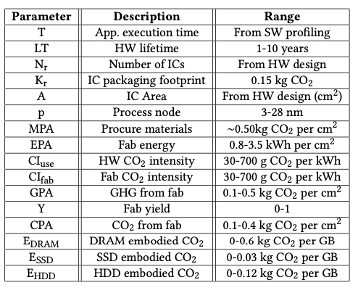
Additional details found in the paper…
ACT parameters
Notes:
We take a similar approach for modeling emissions for memory and storage units which can be found in the paper.

Slide 29
Challenge: How do we design sustainable systems by considering the footprint across lifecycles
This work: Architectural Carbon Modeling Tools (ACT)
Overview of ACT
Comparing ACT to other methodologies
Sustainability aware-design case studies

Slide 30


Current carbon accounting methodologies
Economic Input/Output
(EIO)
Life cycle analysis
(LCA)
Carbon is tied directly to economic cost which is susceptible to market effects.
Current databases are out-of-date (45nm or older nodes).
LCA’s take high $$ and time to conduct.
Notes:
EIO: A cost-based methodology to translate component price into embodied carbon footprint
LCA: A database-based methodology to quantify systems’ embodied emissions
Exergy: A methodology based on evaluating the thermodynamic energy in devices

Slide 31
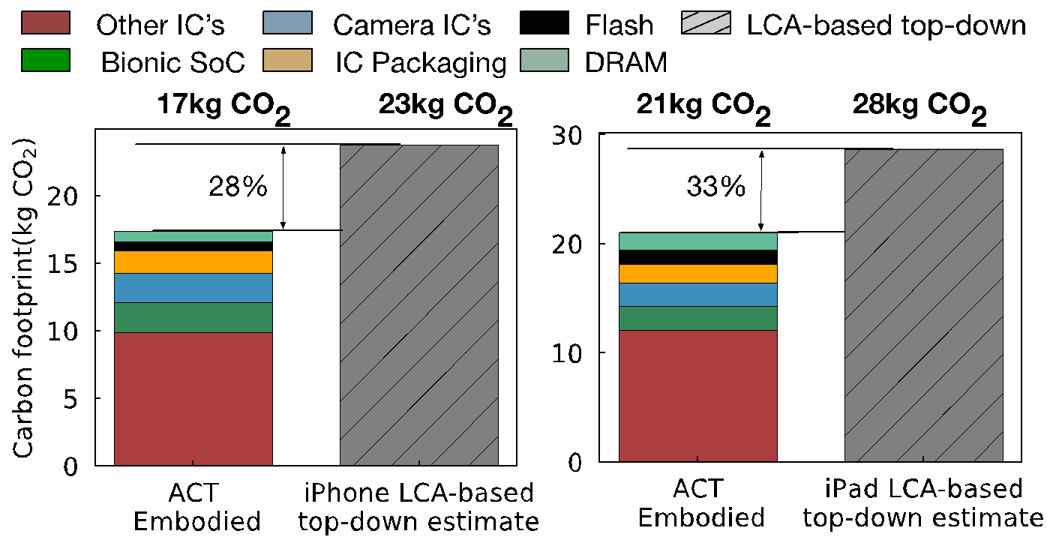
Comparing ACT with Apple’s product environmental reports
ACT embodied
estimate
Apple iPhone
estimates
ACT embodied
estimate
Apple iPad
estimates

Slide 32
Comparing ACT with Apple’s product environmental reports
ACT embodied
estimate
Apple iPhone
estimates
ACT embodied
estimate
Apple iPad
estimates

Slide 33

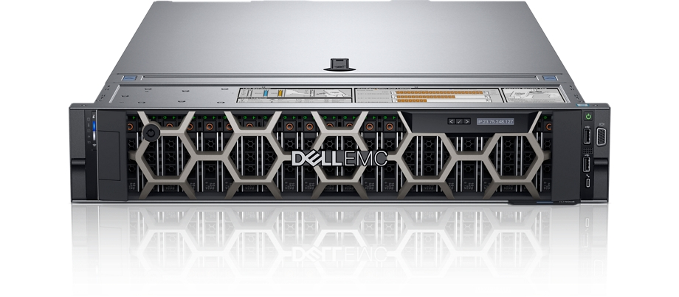
More comparisons (ACT vs. LCA’s) in the paper…
 | ACT vs. Dell R740 server LCA | ACT vs. Fairphone 3 mobile device LCA

Slide 34
More comparisons (ACT vs. LCA’s) in the paper…
IC component | ACT vs. Dell R740 server LCA | ACT vs. Fairphone 3 mobile device LCA
Compute (processors, SoC’s) | Within 2.2x | Within 1.18x
Memory | Within 1.62x | Within 2.1x
Storage | Within 1.05-2.2x
Takeaways
ACT provides first-order approximate of LCA’s that use old technology nodes (45nm NAND, 32nm CPU)
ACT enables architects to study new technology nodes

Slide 35

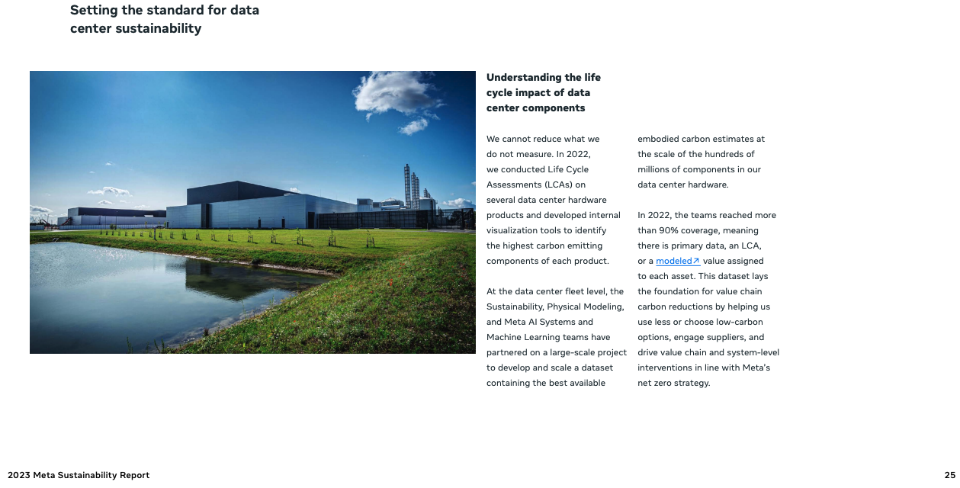

Slide 36
Challenge: How do we design sustainable systems by considering the footprint across lifecycles
This work: Architectural Carbon Modeling Tools (ACT)
Overview of ACT
Comparing ACT to other methodologies
Sustainability aware-design case studies

Slide 37

Tenets of Environmental Design
Reduce
Design leaner footprint software and hardware.
Recycle
Reuse
Recover discarded systems and components.
Repurpose systems already produce.

Slide 38
Tenets of Environmental Design
Reduce
Design leaner footprint software and hardware.
Recycle
Reuse
Recover discarded systems and components.
Repurpose systems already produce.

Slide 39
Reuse: General purpose versus custom mobile HW
AI inference case study (MobileNet) assuming 3 year hardware lifetime, and same utilization in all cases
Commodity (mobile CPU)
Specialized (mobile GPU, DSP)
Architectural
Carbon Model
Carbon per inference

Slide 40
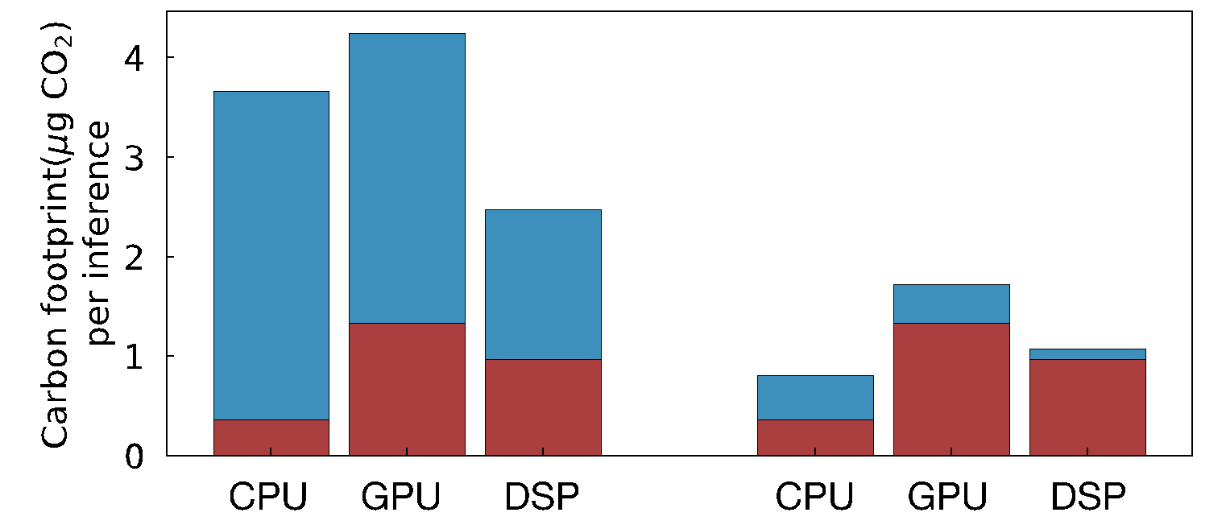
Reuse: General purpose versus custom mobile HW
AI inference case study (MobileNet) assuming 3 year hardware lifetime, and same utilization in all cases
Commodity (mobile CPU)
Specialized (mobile GPU, DSP)
Architectural
Carbon Model
Carbon per inference
Without renewables
during operation
With renewables
during operation

Slide 41
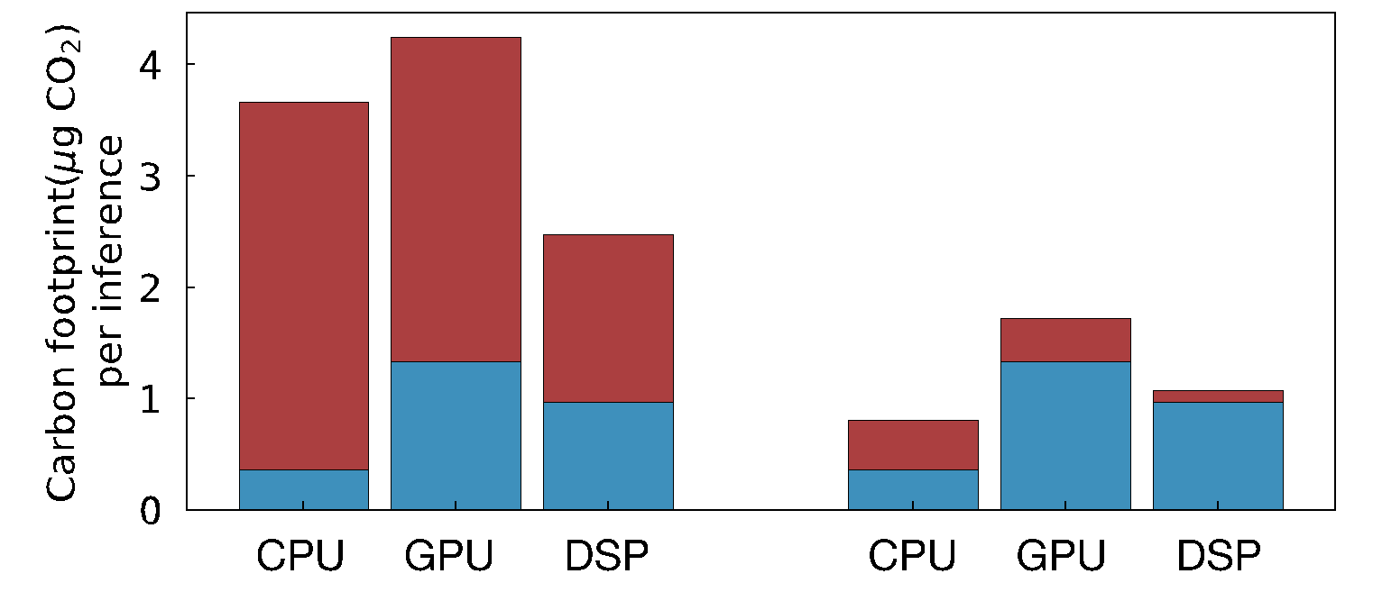
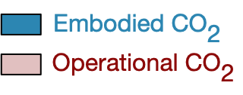
Reuse: General purpose versus custom mobile HW
AI inference case study (MobileNet) assuming 3 year hardware lifetime, and same utilization in all cases
Commodity (mobile CPU)
Specialized (mobile GPU, DSP)
Architectural
Carbon Model
Carbon per inference
DSP
optimal
Without renewables
during operation
With renewables
during operation

Slide 42
Reuse: General purpose versus custom mobile HW
AI inference case study (MobileNet) assuming 3 year hardware lifetime, and same utilization in all cases
Commodity (mobile CPU)
Specialized (mobile GPU, DSP)
Architectural
Carbon Model
Carbon per inference
DSP
optimal
Without renewables
during operation
With renewables
during operation

Slide 43
Reuse: General purpose versus custom mobile HW
AI inference case study (MobileNet) assuming 3 year hardware lifetime, and same utilization in all cases
Commodity (mobile CPU)
Specialized (mobile GPU, DSP)
Architectural
Carbon Model
Carbon per inference
DSP
optimal
CPU
optimal
3x reduction
Without renewables
during operation
With renewables
during operation

Slide 44
Tenets of Environmental Design
Reduce
Design leaner footprint software and hardware.
Recycle
Reuse
Recover discarded systems and components.
Repurpose systems already produce.

Slide 45
Reduce: Designing leaner hardware systems
Architectural
Carbon Model
Performance/energy vs.
Carbon
Nvidia DL Accelerator (NVDLA)

Slide 46
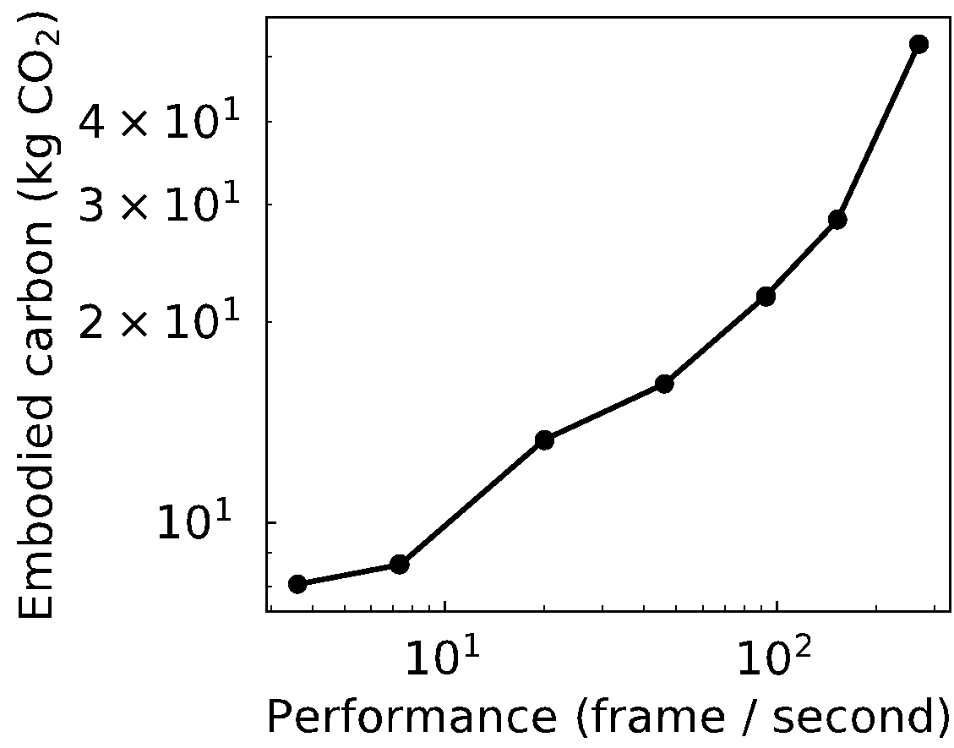
Reduce: Designing leaner hardware systems
Architectural
Carbon Model
Performance/energy vs.
Carbon
Nvidia DL Accelerator (NVDLA)
30 FPS target
30 FPS target

Slide 47
Reduce: Designing leaner hardware systems
Architectural
Carbon Model
Performance/energy vs.
Carbon
Nvidia DL Accelerator (NVDLA)
30 FPS target

Slide 48
Reduce: Designing leaner hardware systems
Architectural
Carbon Model
Performance/energy vs.
Carbon
Nvidia DL Accelerator (NVDLA)
Performance
opt.
Energy
opt.
30 FPS target

Slide 49
Reduce: Designing leaner hardware systems
Architectural
Carbon Model
Performance/energy vs.
Carbon
Nvidia DL Accelerator (NVDLA)
Performance
opt.
3x carbon decrease!
CO₂ opt.
Energy
opt.
30 FPS target

Slide 50
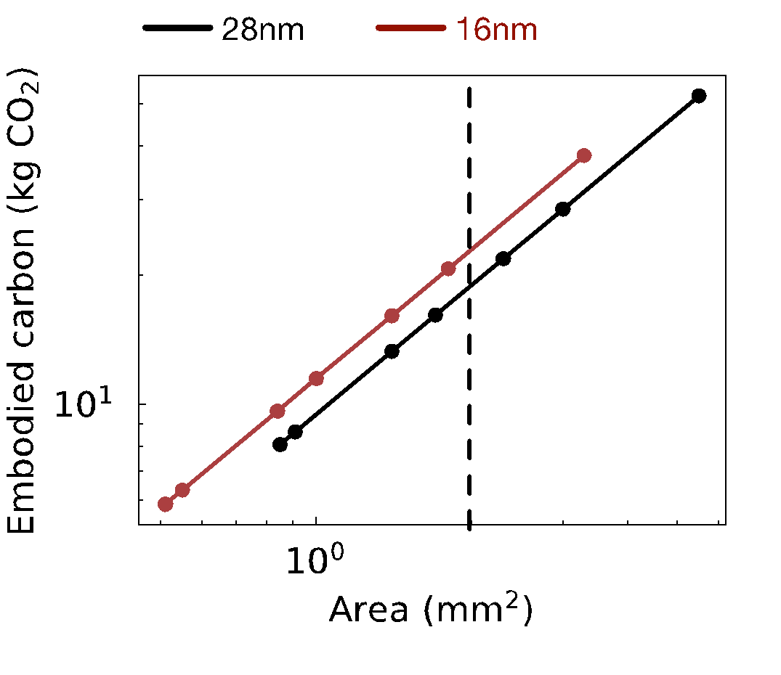
Reduce: Designing leaner hardware systems
Architectural
Carbon Model
Performance/energy vs.
Carbon
Nvidia DL Accelerator (NVDLA)
Performance
opt.
3x carbon decrease!
CO₂ opt.
Energy
opt.
30 FPS target
2mm² area

Slide 51
Reduce: Designing leaner hardware systems
Architectural
Carbon Model
Performance/energy vs.
Carbon
Nvidia DL Accelerator (NVDLA)
Performance
opt.
3x carbon decrease!
CO₂ opt.
Energy
opt.
30 FPS target
2mm² area

Slide 52
Reduce: Designing leaner hardware systems
Architectural
Carbon Model
Performance/energy vs.
Carbon
Nvidia DL Accelerator (NVDLA)
Performance
opt.
30% carbon increase
(Jevon’s paradox)
3x carbon decrease!
CO₂ opt.
Energy
opt.
30 FPS target
2mm² area

Slide 53
Tenets of Environmental Design
Reduce
Design leaner footprint software and hardware.
Recycle
Reuse
Recover discarded systems and components.
Repurpose systems already produce.

Slide 54
Recycle: Extending hardware lifetime
Mobile SoC’s
Geekbench characterization
Architectural
Carbon Model
Operational vs.
Embodied carbon

Slide 55
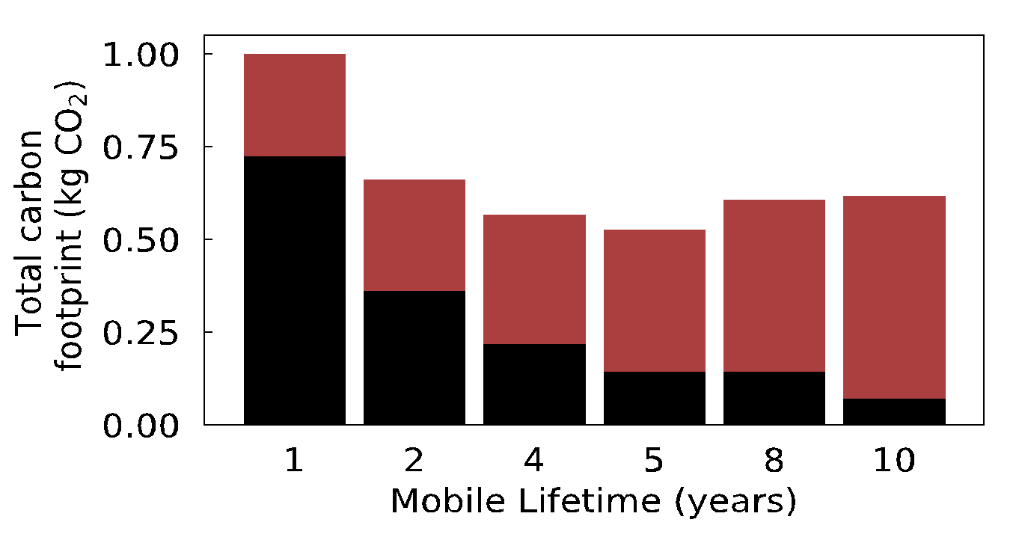
Recycle: Extending hardware lifetime
Mobile SoC’s
Geekbench characterization
Architectural
Carbon Model
Operational vs.
Embodied carbon
Embodied CO₂
Operational CO₂

Slide 56
Recycle: Extending hardware lifetime
Mobile SoC’s
Geekbench characterization
Architectural
Carbon Model
Operational vs.
Embodied carbon
Embodied CO₂
Operational CO₂
Embodied
reduction
Operational
degradation

Slide 57
Recycle: Extending hardware lifetime
Mobile SoC’s
Geekbench characterization
Architectural
Carbon Model
Operational vs.
Embodied carbon
Embodied CO₂
Operational CO₂
Embodied
reduction
Operational
degradation
Enabling 2nd life
requires enhancing
HW reliability
See paper for case
study on storage
reliability using
SSD overprovisioning

Slide 58
Tenets of Environmental Design
Application
Reduce
Design leaner footprint software and hardware.
OS/Run-time
Systems
Compiler
Architecture
Recycle
Reuse
Circuits
Repurpose systems already produce.
Recover discarded systems and components.
Devices &
Technology

Slide 59
Leveraging Eco-Feedback for Carbon-Aware SLO’s
Application
OS/Run-time
Systems
Compiler
Architecture
Circuits
Devices &
Technology
Added latency delay (ms)
Notes:
Finally, given our understanding of carbon emissions, we will conclude by charting paths for how to design future sustainable computing systems.

Slide 60
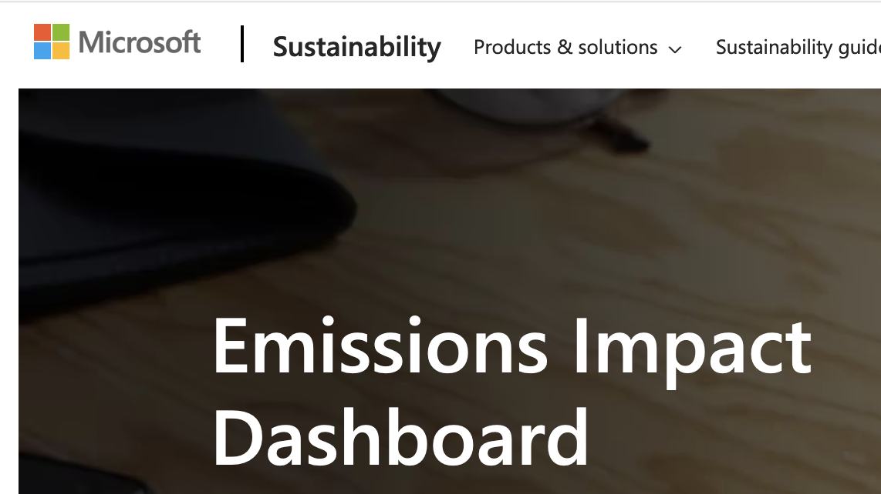


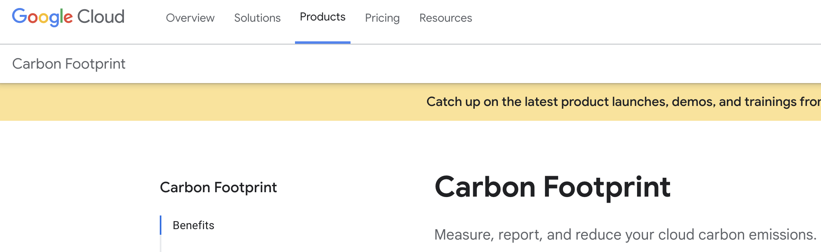
Attributing carbon footprint of cloud usage
Application
OS/Run-time
Systems
Compiler
Architecture
Circuits
Devices &
Technology

Slide 61
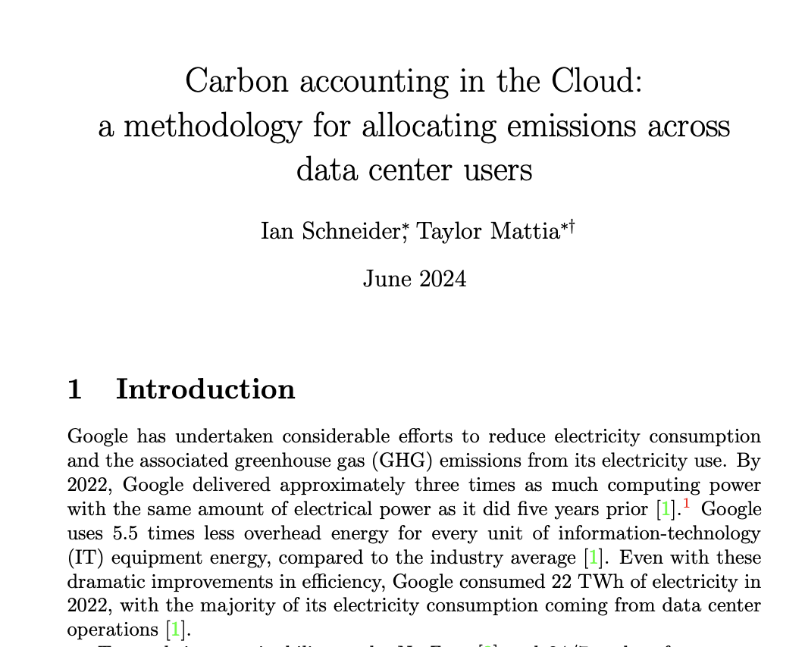
Fairly attributing carbon
Application
OS/Run-time
Systems
Compiler
Architecture
Circuits
Devices &
Technology

Slide 62
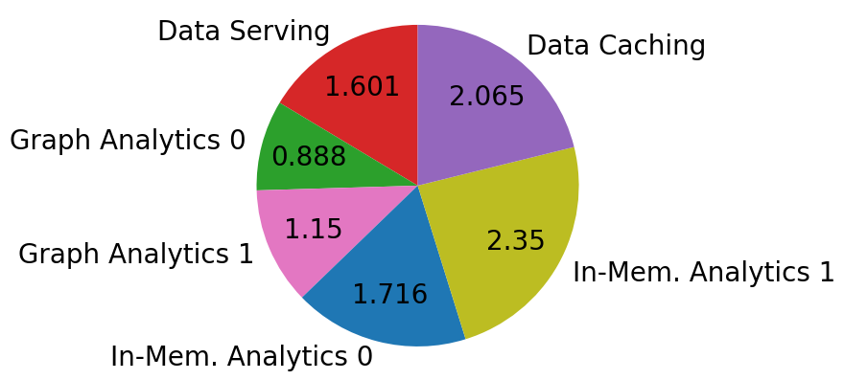
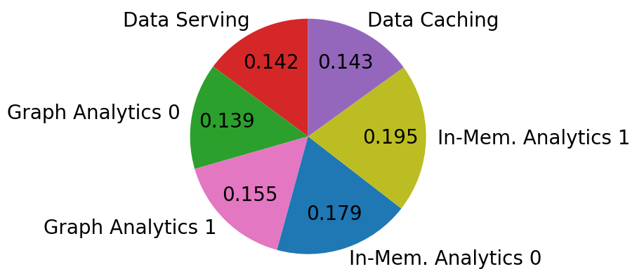
Fairly attributing carbon
Application
Open research questions:
How do we fairly attribute operational and embodied carbon to individual cloud services?
How do we consider varying demand in data centers in attributing carbon responsibility?
How do we scale attribution mechanisms to cloud-scale?
OS/Run-time
Systems
Compiler
Architecture
Operational Breakdown
Circuits
Devices &
Technology
Embodied Breakdown

Slide 63
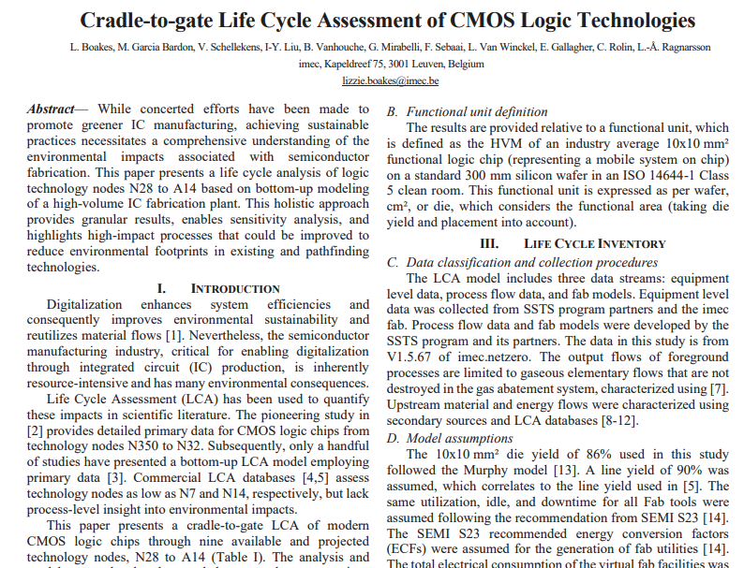
Uncertainty is inherent in carbon accounting

Slide 64
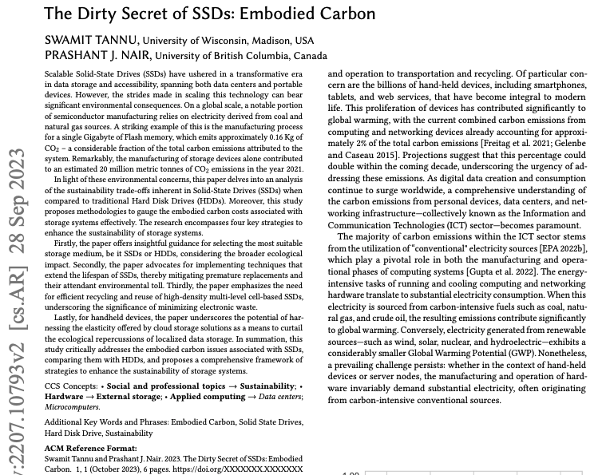
Uncertainty is inherent in carbon accounting

Slide 65
Uncertainty is inherent in carbon accounting
Open research questions:
What magnitude uncertainty exists across all IC components?
What degree of uncertainty exists in embodied versus operational carbon?
How do we consider uncertainty in carbon-aware hardware design to enable robust sustainable computing decisions?
*Attend our group’s talk “Understanding the Implications of Uncertainty in Embodied Carbon Models for Sustainable Computing” (Session 4)

Slide 66
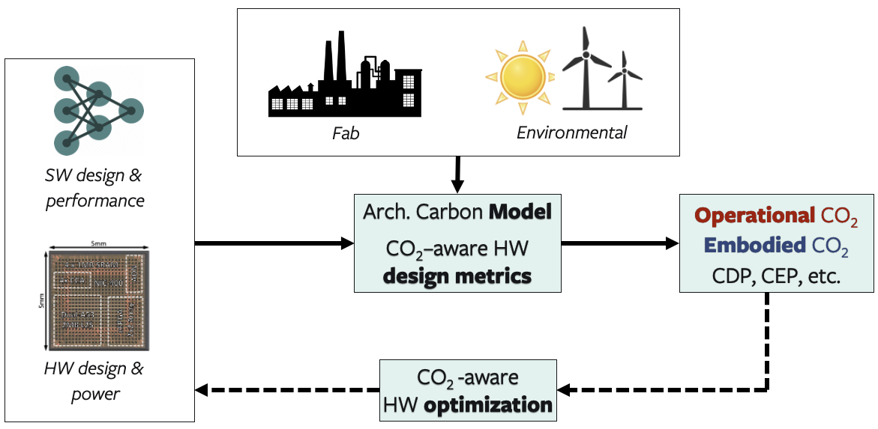
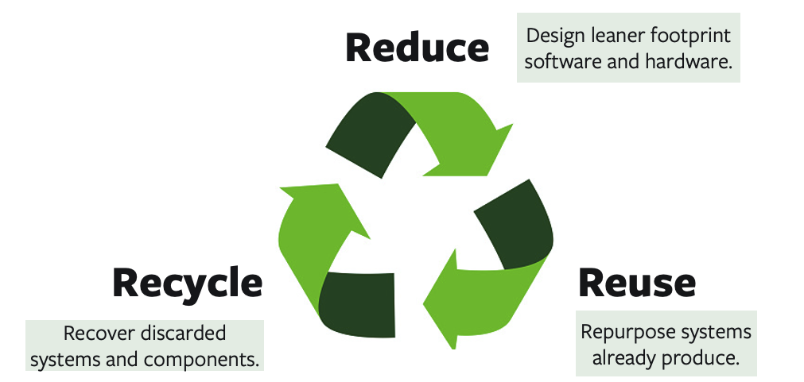
This work: ACT
Develop the model
Case studies

Slide 67
This work: ACT
Develop the model
Case studies
More details in the paper!
Modeling parameters and industry sources for data
Carbon-aware metrics for early DSE (e.g., EDP, CDP, CEP)
Detailed comparison against industry LCA’s
Reuse case study: impact of reconfigurable accelerators (FPGA’s)
Recycle case study: Enabling second life & SSD provisioning

Slide 68
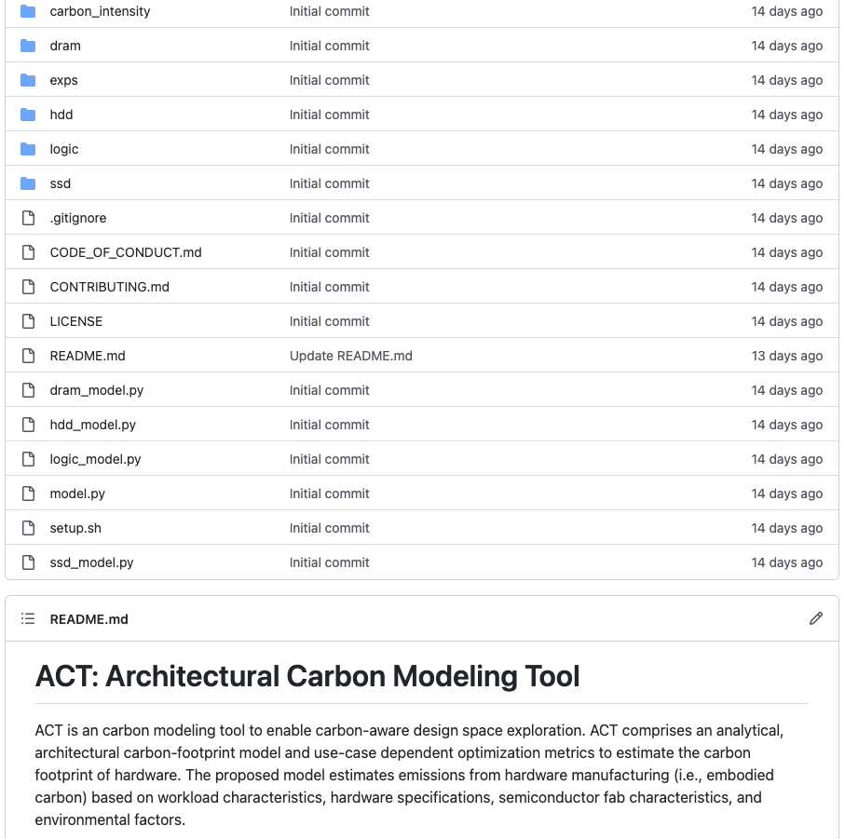

Thank you!
This work: ACT
Develop the model
Case studies
Open-source!
More details in the paper!
Modeling parameters and industry sources for data
Carbon-aware metrics for early DSE (e.g., EDP, CDP, CEP)
Detailed comparison against industry LCA’s
Reuse case study: impact of reconfigurable accelerators (FPGA’s)
Recycle case study: Enabling second life & SSD provisioning

Slide 69
ACT Tutorial: Today
Time | Topic
1:00 – 1:15pm | Welcome to the ACT tutorial!
1:15 – 1:30pm | Motivation: Understanding the source of computing’s emissions
1:30 – 2:15pm | Overview of ACT: An Architectural Carbon Modeling Tool
2:15 –2:45pm | Hands-on ACT demo’s
2:45 – 3:00pm | Extending ACT
3:00 – 3:30pm | Coffee break
Notes:
Finally, given our understanding of carbon emissions, we will conclude by charting paths for how to design future sustainable computing systems.

